Slide 1

JHIPSTER
PRESENTORS
SAMYUKTHA E S
245106
AMRUTHA M NAIR
245138

Slide 2
What is Jhipster?
JHipster is an open-source development platform and a popular application generator used to create modern web applications and microservices. It stands for "Java Hipster" and provides developers with a streamlined way to scaffold, develop, and deploy applications.

Slide 3
FEATURES OF JHIPSTER Spring Boot: JHipster leverages the power of Spring Boot to create Java-based backend applications. Angular or React: JHipster supports both Angular and React as frontend frameworks, allowing developers to choose their preferred technology for building the user interface of their applications.
Microservices Architecture: JHipster supports the development of microservices-based architectures, allowing developers to create modular and scalable applications. Security and Authentication: JHipster includes built-in support for user authentication and authorization. DevOps and Deployment: JHipster provides tooling and configurations to facilitate the deployment and management of applications in various environments.

Slide 4
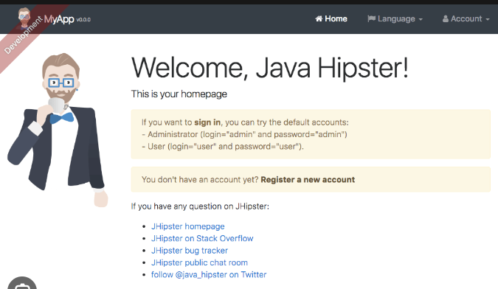

Slide 5
ADVANTAGES
Rapid Application Development: JHipster provides a streamlined development process by automating common tasks and generating project structures, which saves significant time and effort.
Full-Stack Development: JHipster allows developers to work on both the backend and frontend of an application. It integrates popular frameworks like Spring Boot for the backend and Angular or React for the frontend.
Extensibility and Customization: While JHipster provides a predefined structure and configurations, it also offers flexibility for customization. Developers can easily modify and extend the generated code to fit their specific requirements..
Security and Authentication: JHipster includes built-in support for security and authentication.

Slide 6
DISADVANTAGES
Learning Curve: JHipster incorporates multiple frameworks and technologies, which can result in a steep learning curve for developers who are not familiar with all the components involved.
Limited Flexibility: While JHipster provides a structured and opinionated approach to application development, it may limit flexibility in certain cases.
Overhead and Complexity: JHipster generates a significant amount of code and configuration files to support its features and integrate multiple frameworks.
Complexity for Smaller Projects: JHipster is designed to handle complex applications and microservices architectures. For smaller or simpler projects, the additional features and configurations generated by JHipster may introduce unnecessary complexity and overhead.

Slide 7
REFERENCES ​ https://www.youtube.com/watch?v=5GMzVQIovOc&t=764s​ ​ https://github.com/AMRUTHA001/Jhipster.git https://github.com/AMRUTHA001/Jhipster.git

